Slide 1
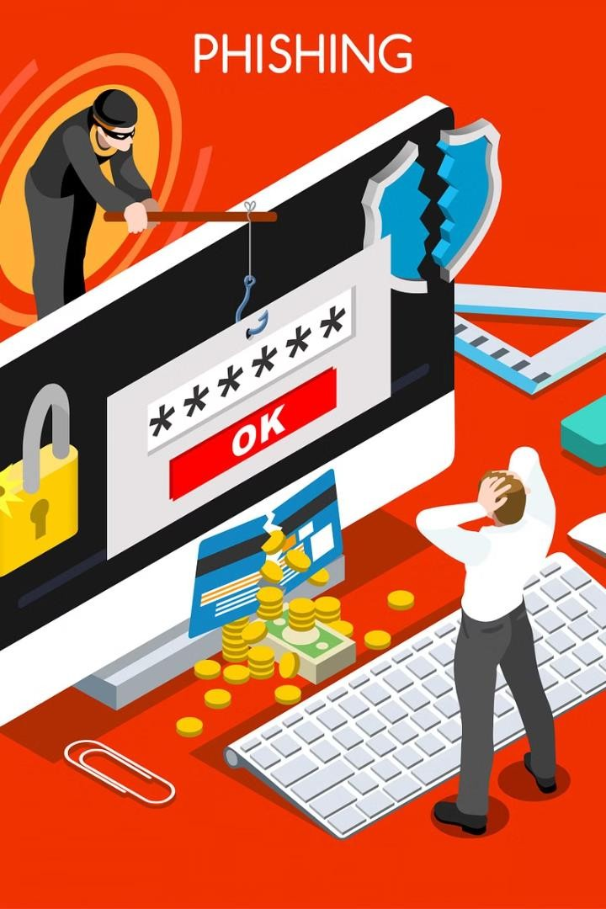
Phishing Attack Incident in Real Time or
online financials scams
In this presentation, we will explore a real-time case study of a phishing attack incident, highlighting the importance of cybersecurity awareness and the steps taken to address the threat.
BY, K.MAHABOOB FATHINA.

Slide 2

Phishing Attack Incident in Real Time
Comprehensive Overview
This presentation provides a real-time account of a phishing attack incident, detailing the steps taken to respond and the value proposition of the proposed solution.
Insightful Agenda
The agenda covers the problem statement, project overview, user analysis, incident response, and the wow- factor of the presented solution.
Actionable Insights
By the end of this presentation, you will gain a deep understanding of how to effectively mitigate phishing attacks and protect your organization.

Slide 3

Agenda
Understand the problem of phishing attacks and their impact on organizations.
Explore the steps involved in an effective incident response plan to mitigate phishing threats.
Discuss the key features and value proposition of the proposed
solution to address phishing attacks.
Showcase the user-friendly and intuitive design of the solution through interactive wireframes.

Slide 4
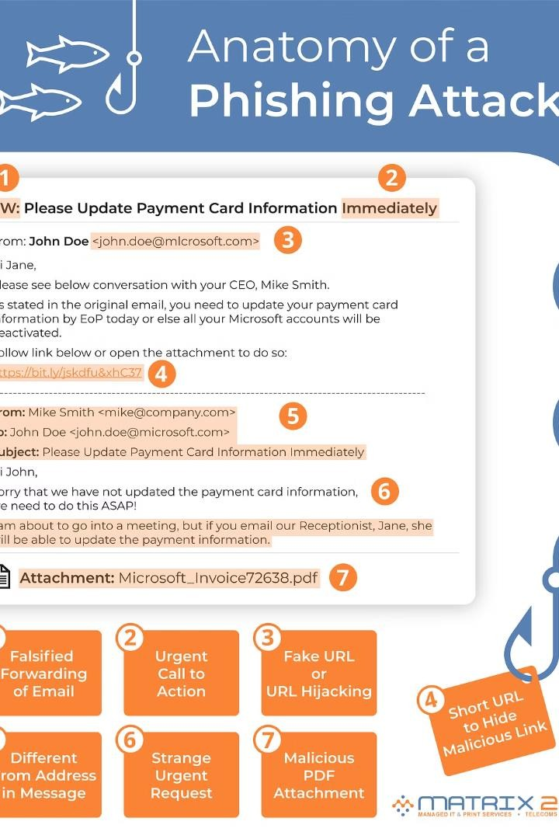
Problem Statement
Phishing attacks are a growing threat, where attackers try to trick users into revealing sensitive information or installing malware. This project aims to address the challenge of detecting and responding to phishing incidents in real-time, protecting organizations and individuals from the significant financial and reputational damage these attacks can cause.

Slide 5
PROJECT OVERVIEW
Our project aims to address the growing threat of phishing attacks in real-time. Phishing scams have become increasingly sophisticated, putting individuals and organizations at risk of financial and data breaches. Our solution provides proactive protection to identify and mitigate these threats before they can cause harm.

Slide 6




WHO ARE THE END USERS?
Security Professionals
Security analysts, incident response teams, and cybersecurity experts who need to respond to phishing attacks in real-time.
Business Leaders
Executives, managers, and decision-makers who want to understand the impact of phishing attacks and implement effective countermeasures.
Employees
End-users who need to be educated on identifying and reporting phishing attempts to protect the organization.
IT Teams
IT professionals responsible for implementing security solutions and training employees to mitigate phishing risks.

Slide 7
Incident Response Steps
Detect
Quickly identify the phishing attack and contain the damage by isolating affected systems.
Analyze
Investigate the incident to understand the scope, source, and tactics used by the attackers.
Remediate
Remove the malware, reset credentials, and patch vulnerabilities to prevent further exploitation.
Recover
Restore normal operations, retrieve any lost data, and implement measures to enhance security.

Slide 8
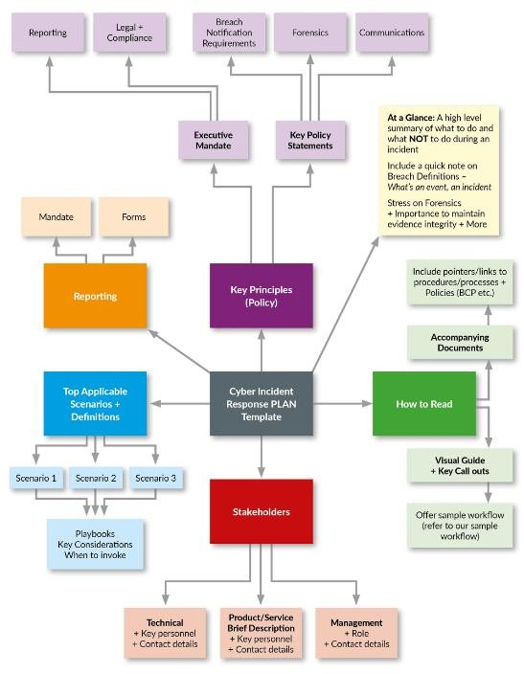
YOUR SOLUTION AND ITS VALUE PROPOSITION
Our solution provides a comprehensive incident response plan to mitigate the impact of phishing attacks in real-time. By leveraging automated threat detection and rapid response capabilities, we can quickly identify and contain phishing threats, minimizing data breaches and financial losses.
The key value proposition of our solution is its ability to proactively protect your organization and employees from the devastating consequences of phishing attacks. With our solution, you can have peace of mind knowing that your critical data and assets are safeguarded against these persistent cyber threats.

Slide 9



THE WOW IN YOUR SOLUTION
AI-Powered Threat Detection
Cutting-edge machine learning algorithms analyze user behavior and network traffic in real-time
1
Automated Incident Response
Instantly respond to threats, neutralize attacks, and alert the security team
2
Comprehensive Reporting
Detailed logs and analytics provide full visibility into security incidents
3
Our solution goes beyond basic security measures by leveraging the power of artificial intelligence to proactively detect and respond to phishing attacks. The AI-driven threat detection engine monitors user activity and network traffic, instantly identifying anomalies and suspicious behavior. When an attack is detected, the automated incident response system immediately takes action to neutralize the threat and notify the security team, minimizing the impact and allowing for quick remediation.

Slide 10


MODELLING WITH WIREFRAMES
Low-Fidelity Wireframes
We began by creating low-fidelity wireframes to map out the core user flows and functionality of the anti-phishing solution. These skeletal layouts helped us identify key features and user interactions early in the design process.
High-Fidelity Mockups
Next, we developed high-fidelity mockups that brought the wireframes to life with branding, typography, and visual design. These interactive prototypes allowed us to validate the design with end-users and finalize the user interface.

Slide 11
CONCLUSION
Real-time phishing attacks pose a significant and evolving threat to individuals, organizations, and
the integrity of digital systems.
The speed and sophistication with which these attacks are executed demand constant vigilance and
proactive measures to mitigate risks effectively.
As technology advances, so too do the tactics employed by malicious actors, requiring a multi- faceted approach to defense that includes robust cybersecurity protocols, employee education, and the implementation of advanced detection and response mechanisms.
Furthermore, collaboration within the cybersecurity community is essential to stay ahead of emerging threats and protect against the potential consequences of phishing attacks, including data breaches, financial losses, and reputational damage.
By remaining informed, proactive, and collaborative, we can better safeguard our digital ecosystems
against the pernicious effects of real-time phishing attacks.

Slide 12
THANK YOU

